Slide 1
Introduction to Text Mining
08/11/2022
Eléonore Charles

Slide 2


Slide 3
Introduction
Introduction to regular expressions
Introduction to spaCy
Text vectorization
Sentiment analysis modeling
L’Oréal case: custom NER model using prodigy and spacy

Slide 4


Slide 5
1. Introduction
Some definitions

Slide 6
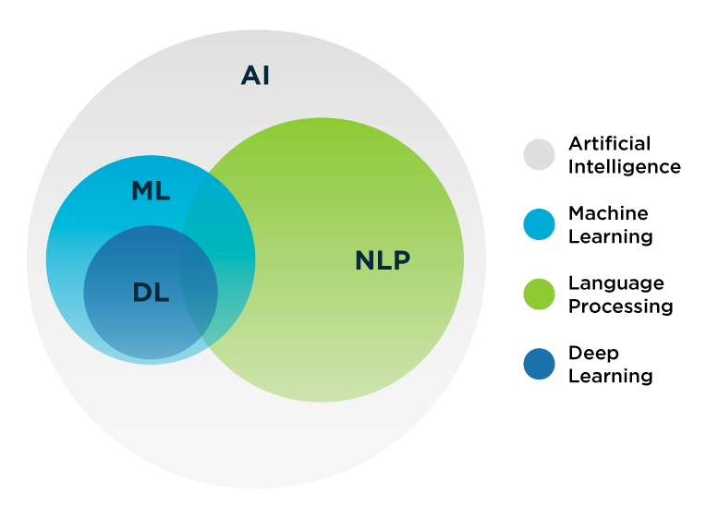
Natural Language Processing (NLP)
Subset of AI in which computers can analyze and interpret human language in an efficient and useful way. It is a way to get a human-level understanding of the language for machines.
The earliest NLP applications were rule-based systems that only performed certain tasks. We then moved towards more complex and powerful NLP solutions based on ML and deep learning techniques.

Slide 7
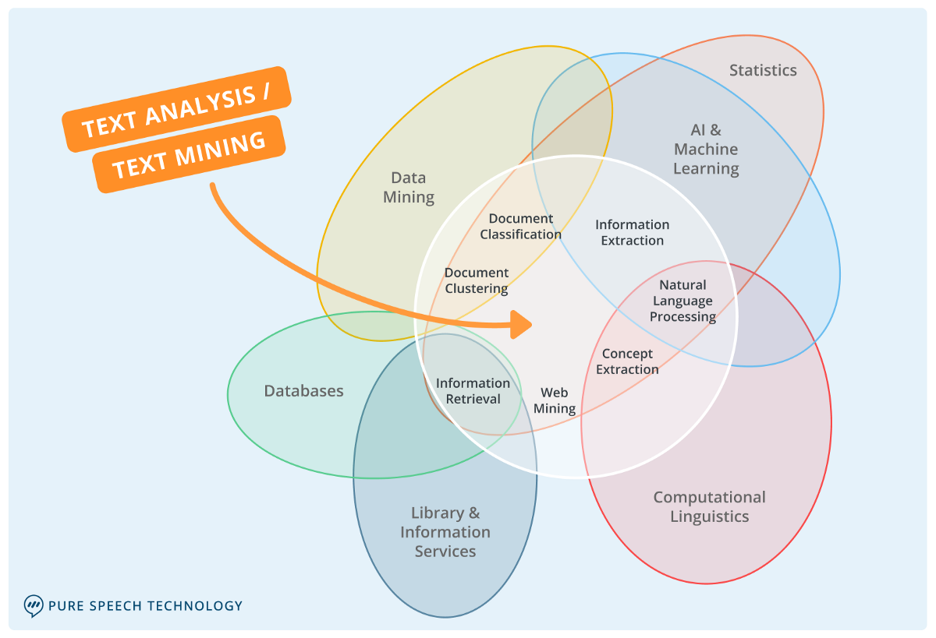
Text mining
Text mining is used to extract information from unstructured and structured content. It focuses on structure rather than the meaning of the content.

Slide 8
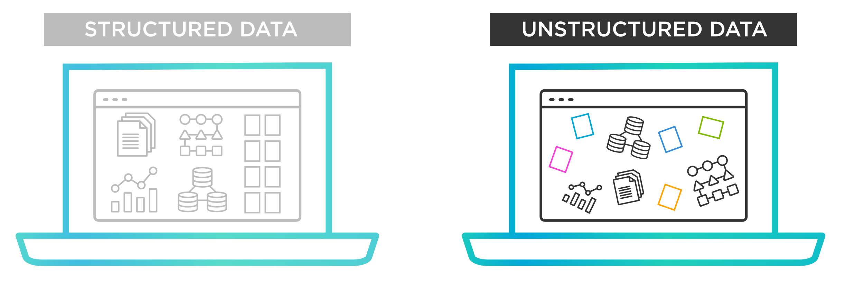
Importance of NLP
Businesses are overwhelmed with unstructured data…

Slide 9
1. Introduction
NLP Use cases

Slide 10
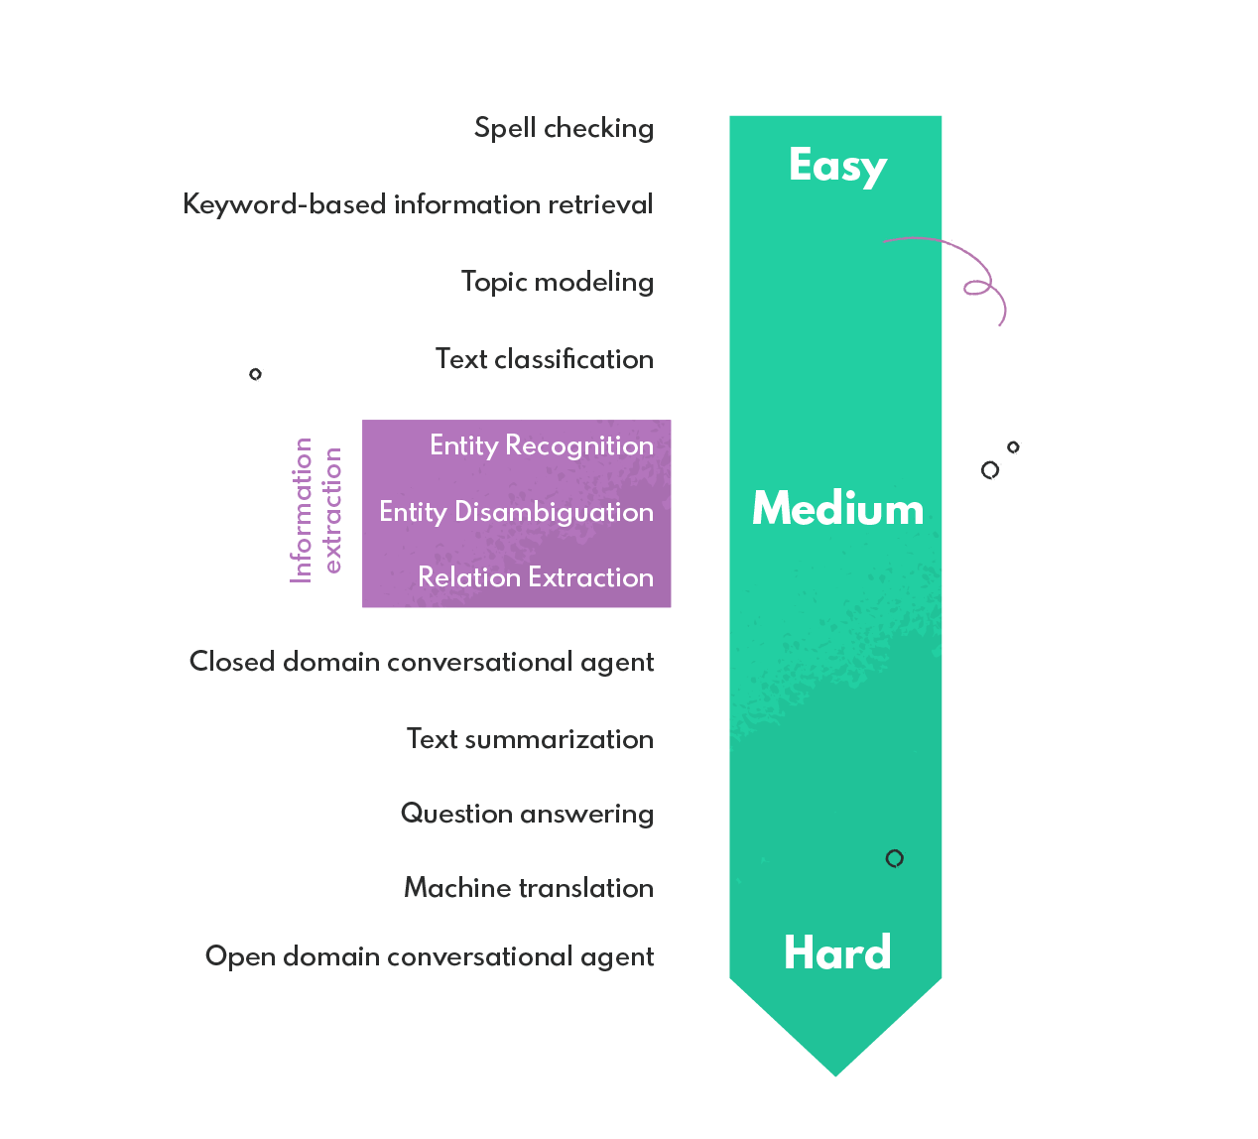
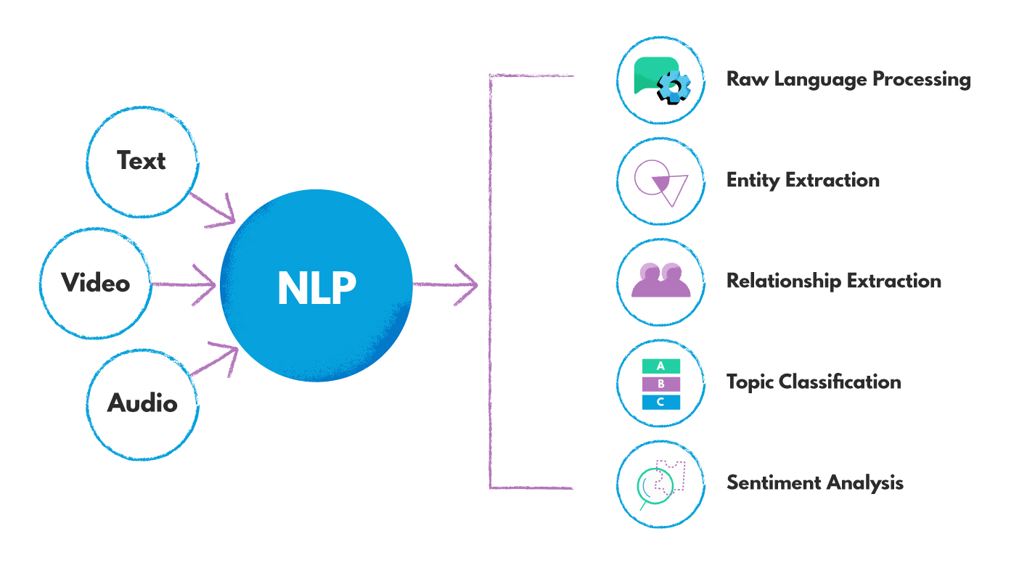
NLP use cases examples

Slide 11
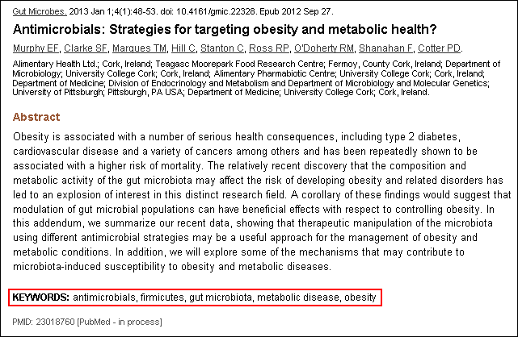
Keyword extraction
Aims to identify all the keywords from a given natural language input.
Services like PubMed auto-tag their articles based on AI keyword extraction.

Slide 12
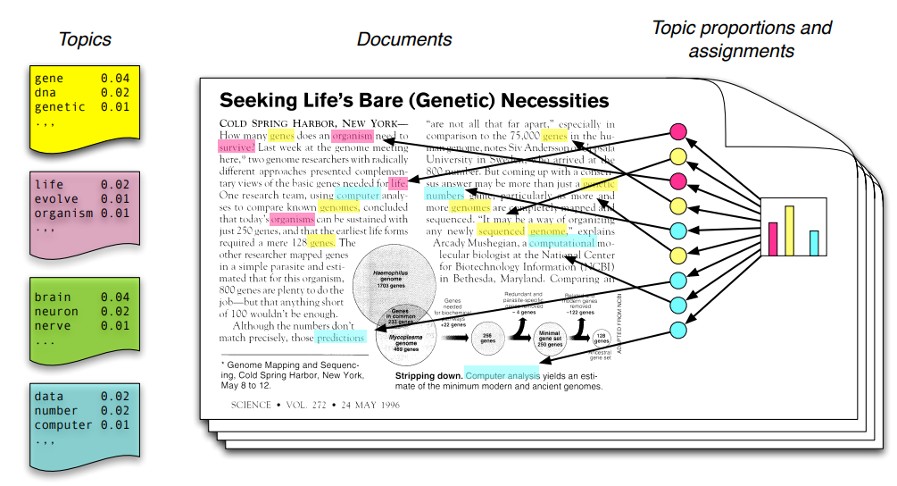
Topic modeling
Unsupervised machine learning technique
Scans a set of documents, detects word and phrase patterns within them, and automatically clusters word groups and similar expressions that best characterize a set of documents.

Slide 13

Text classification
It involves assigning a class to an arbitrary piece of natural language input such as documents, email messages, or tweets.
Text classification has many applications, from spam filtering (e.g., spam, not spam) to the analysis of electronic health records (classifying different medical conditions).
Deep learning methods prove very good at text classification.

Slide 14
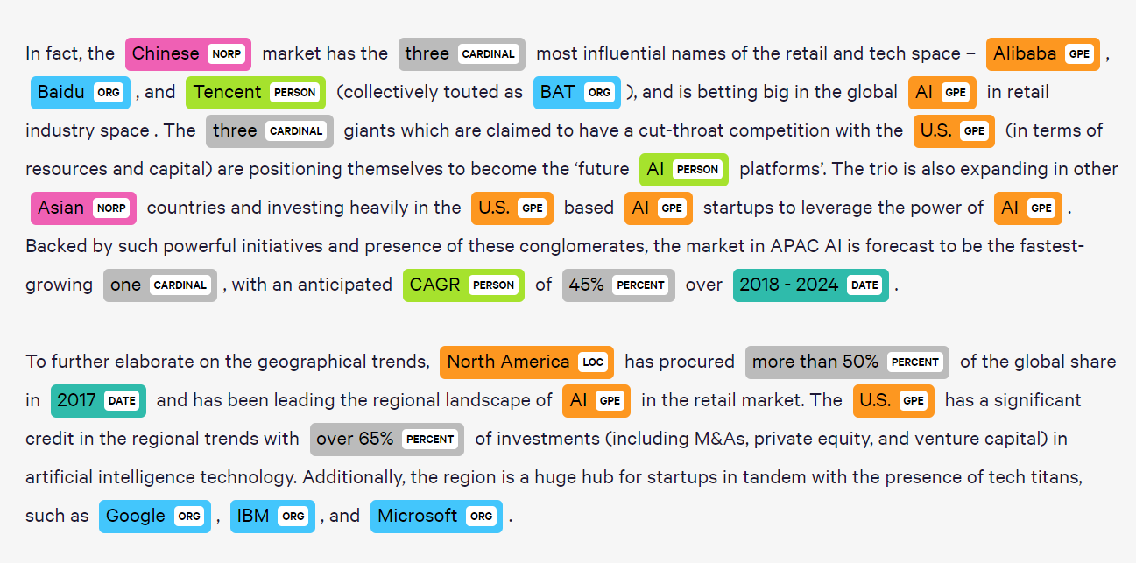
Named Entity Recognition
The entity recognition task involves detecting mentions of specific types of information in natural language input.
Typical entities of interest for entity recognition include people, organizations, locations, events, and products.

Slide 15
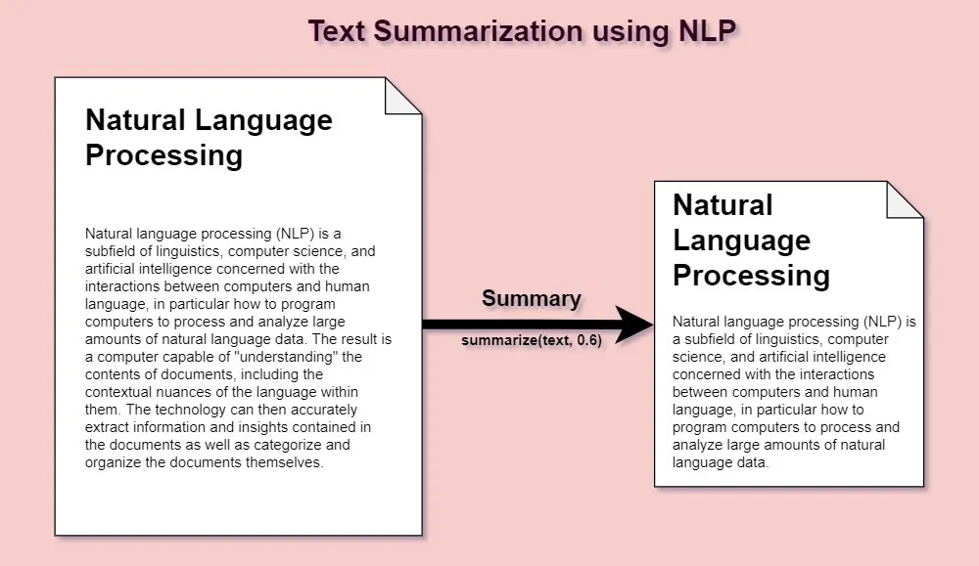
Text Summarization
The text summarization task produces a short extract of arbitrary natural language input, typically a document or article.
The goal is to create a summary that retains the meaning and style of the source: synthesizing high-level concepts while maintaining factual accuracy without excessive detail.

Slide 16

Conversational Agents
The main task of a conversational agent is to have conversations with humans.
The most popular type of conversational agent is chatbots. Their function is to provide the answer or perform the requested action. They are used in many different fields:
telecommunications (providing support),
marketing and sales (24/7 sales and helping customers),
education (languages learning).
However, some challenges come along with designing this kind of technology:
not being able to answer all questions,
the fact that it may feel dehumanizing if an AI doesn’t act like a human would when talking about emotions, etc.,
lack of accuracy due to the complexity inherent to natural languages.

Slide 17
1. Introduction
NLP challenges

Slide 18

NLP challenges
The complexity inherent in human languages can cause inaccuracies and lead machines astray when trying to understand our words and sentences…

Slide 19
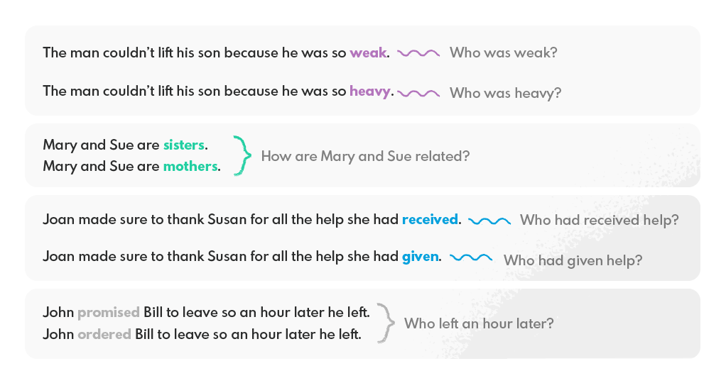
NLP challenges (1)
1. Ambiguity
Ambiguity in natural language processing refers to sentences and phrases interpreted in two or more ways.
Ambiguous sentences are hard to read and have multiple interpretations, which means that natural language processing may be challenging because it cannot make sense out of these sentences.

Slide 20

NLP challenges (2-5)
2. Irony and Sarcasm
Irony, sarcasm, puns, and jokes all rely on this natural language ambiguity for their humor. These are especially challenging for sentiment analysis, where sentences may sound positive or negative but actually mean the opposite.
3. Domain-specific Knowledge
Natural language processing isn’t limited just to understanding what words mean; there’s also interpreting how they should be used within the wider context; background information that may not be explicitly stated but inferred by the program based on surrounding text and domain-specific knowledge.
4. Support for Multiple Languages
The most popular languages, English or Chinese, often have thousands of pieces of data and statistics that are available to analyze in-depth. However, many smaller languages only get a fraction of the attention they deserve and consequently gather far less data on their spoken language.
5. Lack of Trust Towards Machines
Another challenge is designing NLP systems that humans feel comfortable using without feeling dehumanized by their interactions with AI agents who seem apathetic about emotions rather than empathetic as people would typically expect.

Slide 21
1. Introduction
Python packages

Slide 22
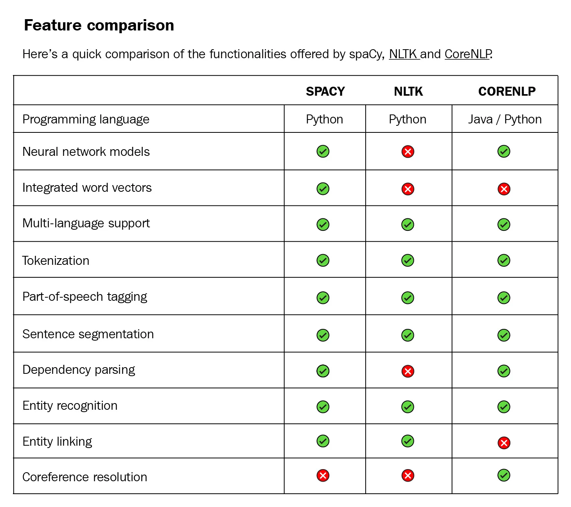
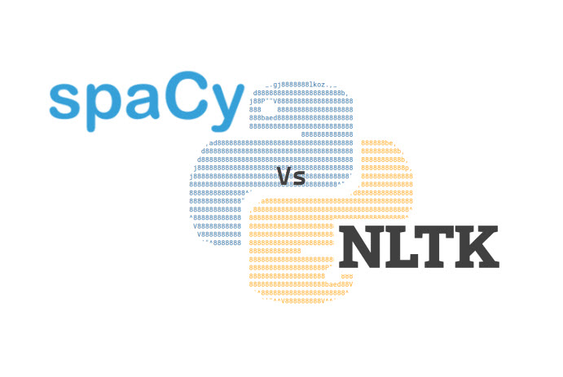
Python packages
Focus for this training!

Slide 23
2. Introduction to regular expressions
Theory

Slide 24

Definition
A RegEx, or Regular Expression, is a sequence of characters that forms a search pattern.
RegEx can be used to check if a string contains the specified search pattern.
They are a powerful mechanism for solving string-matching problems and are supported by all modern programming languages.
However, regexes are hard. They are hard to read, they are hard to write, they are hard to validate, they are hard to search for, and they are hard to document. They are also hard to master.

Slide 25
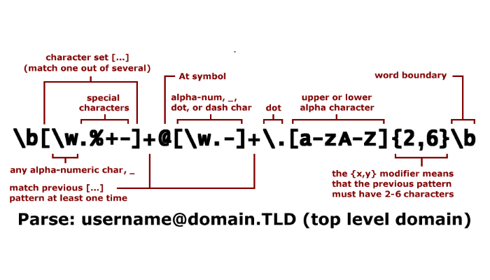
Use cases
Parse emails adresses
Web Scraping
Remove/replace unwanted characters
...

Slide 26

Regex syntax

Slide 27
2. Introduction to regular expressions
Examples

Slide 28
2. Introduction to regular expressions
Useful tools

Slide 29
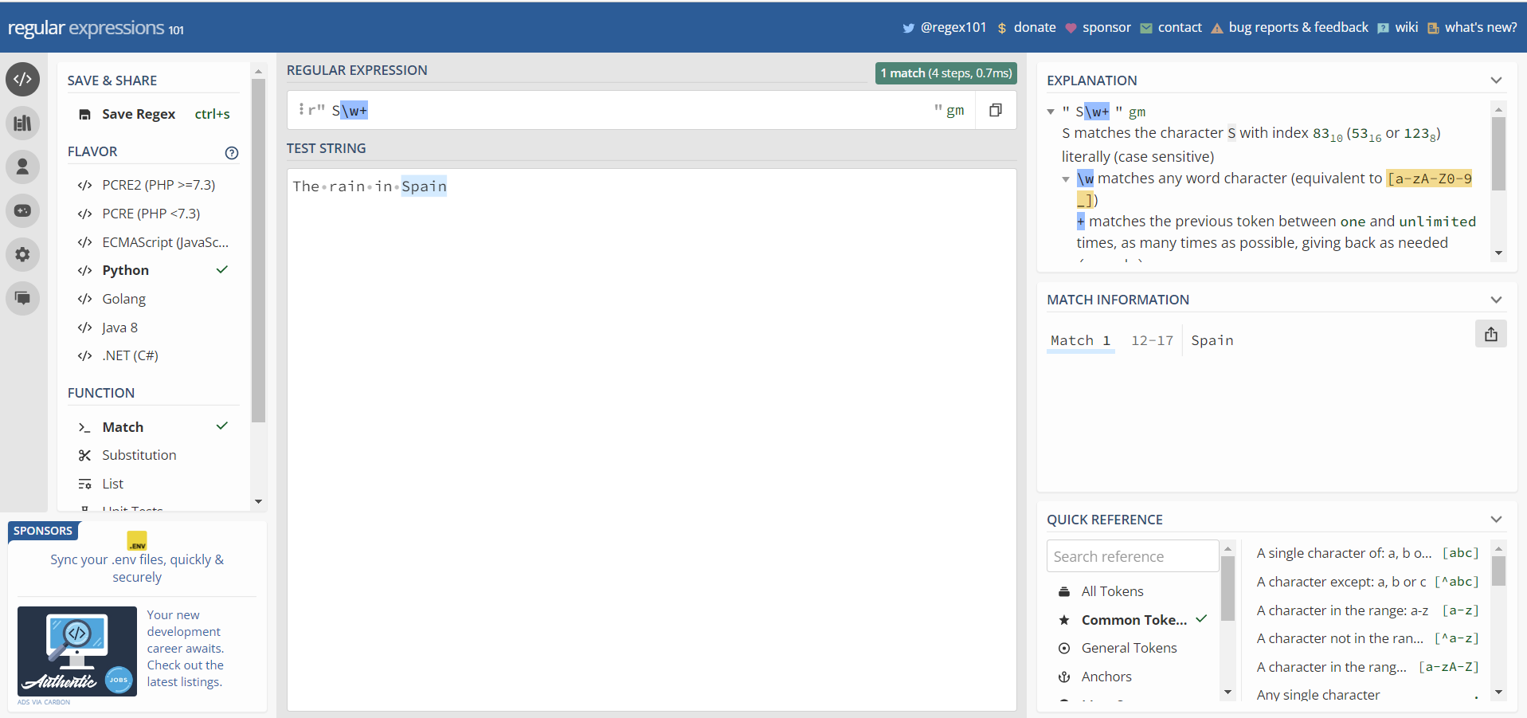
Regex 101
https://regex101.com/ can be used to easily visualize and debug regex in Python.

Slide 30
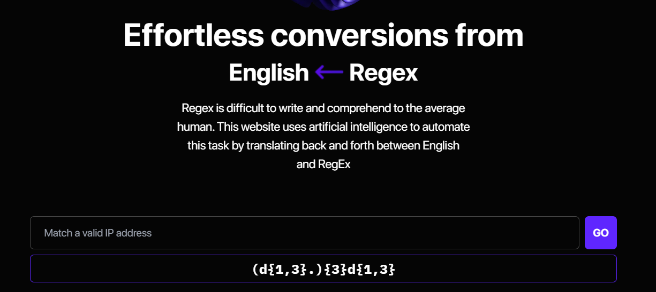
Autoregex
https://www.autoregex.xyz/ uses artificial intelligence to convert natural language text to regular expressions.

Slide 31
2. Introduction to regular expressions
EXercises

Slide 32
3. Introduction to spaCy
nlp object

Slide 33
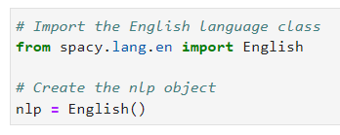
NLP object
At the center of spaCy is the object containing the processing pipeline. We usually call this variable "nlp".
You can use the nlp object like a function to analyze text. It contains all the different components in the pipeline. It also includes language-specific rules used for tokenizing the text into words and punctuation.
spaCy supports a variety of languages that are available in spacy.lang
For example, to create an English nlp object, you can import the English language class from spacy.lang.en and instantiate it.

Slide 34
3. Introduction to spaCy
Documents, spans and tokens

Slide 35
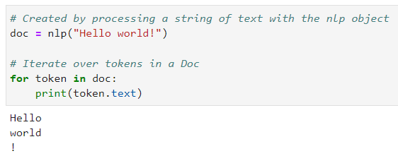
Doc object
When you process a text with the nlp object, spaCy creates a Doc object – short for "document". The Doc lets you access information about the text in a structured way, and no information is lost.
The Doc behaves like a normal Python sequence by the way and lets you iterate over its tokens, or get a token by its index. But more on that later!

Slide 36
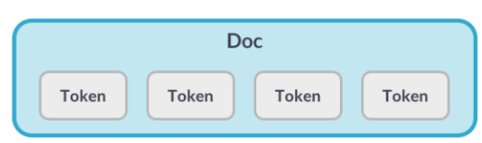
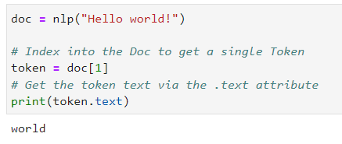
Token object
Token objects represent the tokens in a document – for example, a word or a punctuation character.

Slide 37
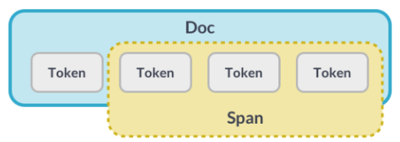
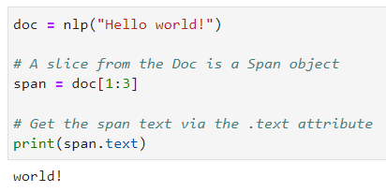
Span object
A Span object is a slice of the document consisting of one or more tokens. It's only a view of the Doc and doesn't contain any data itself.

Slide 38
3. Introduction to spaCy
Lexical attributes

Slide 39
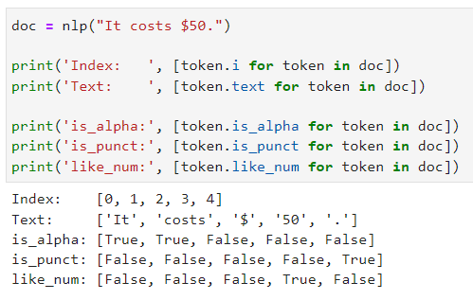
Lexical attributes
We have seen that "text" returns the token text. "text" is what is called a "lexical attribute".
Lexical attributes refer to the entry in the vocabulary and don't depend on the token's context.
Here is an example of other lexical attributes:

Slide 40
3. Introduction to spaCy
Stemming

Slide 41
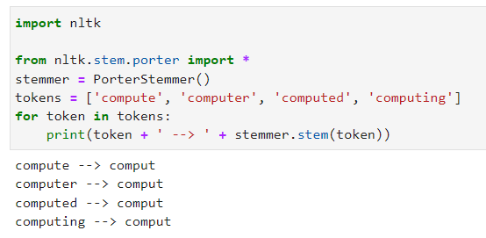
Stemming
Stemming refers to reducing a word to its root form.
While performing natural language processing tasks, you will encounter various scenarios where you find different words with the same root. You may want to reduce the words to their root form for the sake of uniformity.
It might be surprising to you but spaCy doesn't contain any function for stemming as it relies on lemmatization only. Therefore, in this section, we will use NLTK for stemming.
"comput" actually isn't a dictionary word.
Lemmatization reduces the word to its stem as it appears in the dictionary.

Slide 42
3. Introduction to spaCy
Statistical models

Slide 43
Statistical models
Some of the most interesting things you can analyze are context-specific: for example, whether a word is a verb or whether a span of text is a person name.
Statistical models enable spaCy to make predictions in context. This usually includes part-of speech tags, syntactic dependencies and named entities.
Models are trained on large datasets of labeled example texts. They can be updated with more examples to fine-tune their predictions – for example, to perform better on your specific data.
spaCy provides a number of pre-trained model packages you can download using the "spacy download" command. For example, the "en_core_web_sm" package is a small English model that supports all core capabilities and is trained on web text.

Slide 44
3. Introduction to spaCy
Lemmatization

Slide 45
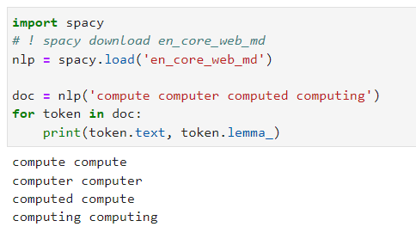
Lemmatization
Though we could not perform stemming with spaCy, we can perform lemmatization using spaCy. To do so, we need to use the lemma_ attribute on the spaCy document.
You can see that unlike stemming where the root we got was "comput", the roots that we got here are actual words in the dictionary.

Slide 46
3. Introduction to spaCy
Sentence segmentation

Slide 47
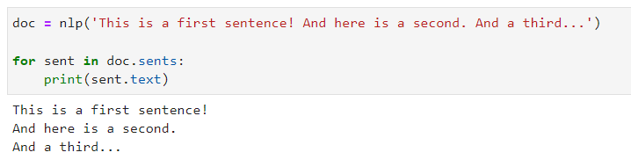
Sentence segmentation
If you have multiple sentences in a text and you want to separate each of the sentences and print the output, then Sentence segmentation comes in handy.

Slide 48
3. Introduction to spaCy
Part of speech tagging

Slide 49
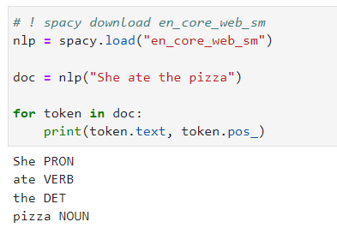
Part of speech tagging
In this example, we're using spaCy to predict part-of-speech tags, the word types in context.
Here, the model correctly predicted "ate" as a verb and "pizza" as a noun.

Slide 50
3. Introduction to spaCy
Syntactic dependencies

Slide 51
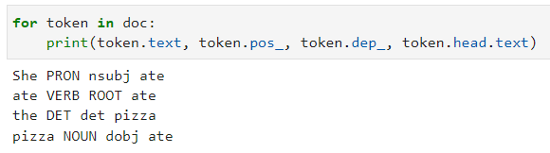
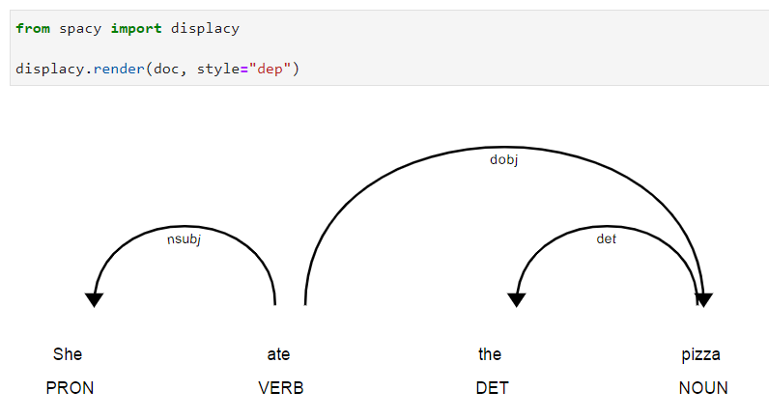
Syntactic dependencies
In addition to the part-of-speech tags, we can also predict how the words are related. For example, whether a word is the subject of the sentence or an object.
The "dep underscore" attribute returns the predicted dependency label. The head attribute returns the syntactic head token. You can also think of it as the parent token this word is attached to.

Slide 52
3. Introduction to spaCy
Named entities recognition

Slide 53
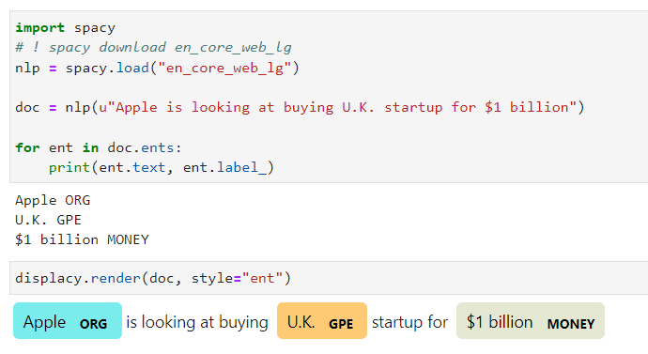
Named entities recognition
Named entities are "real world objects" that are assigned a name – for example, a person, an organization or a country.
The doc dot ents property lets you access the named entities predicted by the model. It returns an iterator of Span objects, so we can print the entity text and the entity label using the "label underscore" attribute.

Slide 54
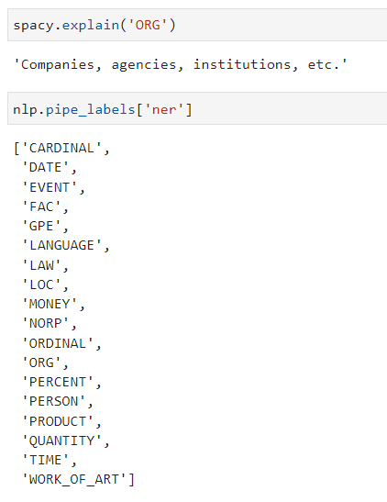
Entities of "en_core_web_lg“ model

Slide 55
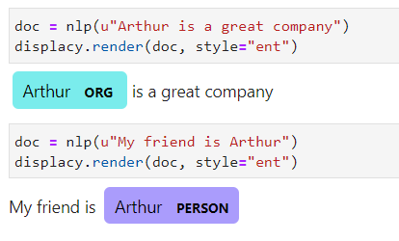
Context dependency
Retrieved entities are dependent on the context (models are trained based on surroundings tokens, ...). The example below illustrates well the context dependency of NER models:

Slide 56
3. Introduction to spaCy
Stop words

Slide 57
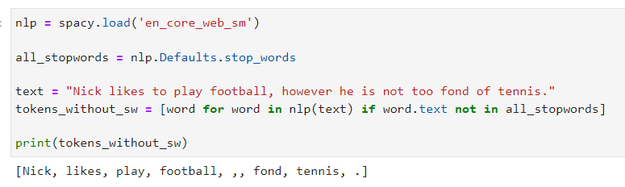
Stop words
Stop words are those words in natural language that have a very little meaning, such as "is", "an", "the", etc.
Stop words are often removed from the text before training machine learning models since stop words occur in abundance, hence providing little to no information that can be used for modelling.
We have seen some features of spaCy but it can do so much more!
Refer to https://spacy.io/usage to discover more about spaCy.

Slide 58
3. Introduction to spaCy
Exercises

Slide 59
4. Text vectorization
Bag of words

Slide 60

Text vectorization
Vectorization is the general process of turning a collection of text documents (a corpus) into numerical feature vectors fed to machine learning algorithms for modeling.
When you vectorize the corpus, you convert each word or token from the documents into an array of numbers. This array is the vector representation of the word.

Slide 61
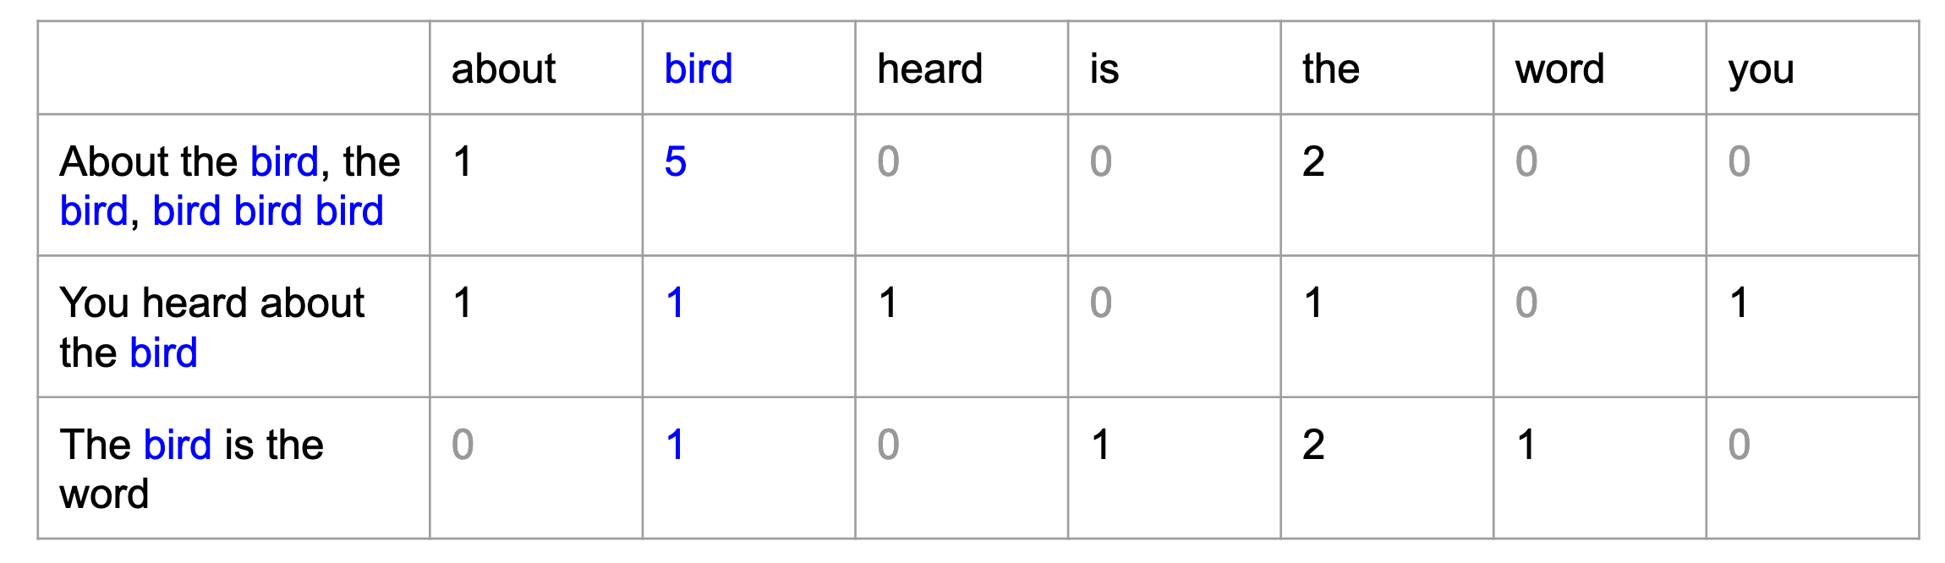
Bag-of-words
Bag-of-words (BOW) is a simple but powerful approach to vectorizing text.
The idea is to count the number of times each word appears in each of the documents.
Consider the three following documents and count the number of times each word appears in each sentence.
The matrix calculated on this simple example of three sentences can be generalized to many documents in the corpus. Each document is a row, and each token is a column. Such a matrix is called the document-term matrix.
Note that the size of the document-term matrix is: number of documents ∗ size of vocabulary

Slide 62
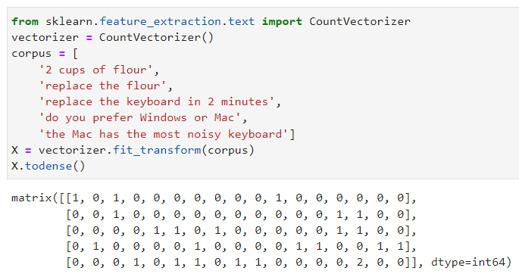
CountVectorizer
You can use the CountVectorizer from scikit-learn to generate the document-term matrix from a corpus with the following code:
The vocabulary is strongly related to the sentence topic: the word "flour" only appears in sentences about recipes. On the other hand, "the" is less specific.
Reducing the size of the vocabulary is important to avoid performing calculations over gigantic matrices. While removing stop words and lemmatizing helps reduce the size of the vocabulary significantly, it's often not enough. The idea is to remove as many tokens as possible without throwing away relevant information. It's a delicate balance that is entirely dependent on the context.
One strategy can be to filter out words that are either too frequent or too rare.
Another strategy involves applying dimension reduction techniques (PCA) to the document-term matrix.

Slide 63
4. Text vectorization
Tf-idf

Slide 64
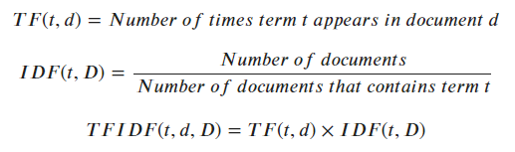
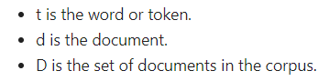
TF-IDF
The problem with counting word occurrences is that some words that are present in all the documents will not bring any information to the model.
For this reason, it is sometimes better to normalize the word counts by the number of times they appear in the documents. This is the general idea behind the tf-idf vectorization.
Let's look more closely at what tf-idf stands for:
Tf stands for term frequency, the number of times the word appears in each document.
Idf stands for inverse document frequency, an inverse count of the number of documents a word appears in. Idf measures how significant a word is in the whole corpus.
If you multiply tf with idf, you get the tf-idf score:
→ A tf-idf score is a decimal number that measures the importance of a word in any document. It gives small values to frequent words in all the documents and more weight to those more scarce across the corpus.

Slide 65
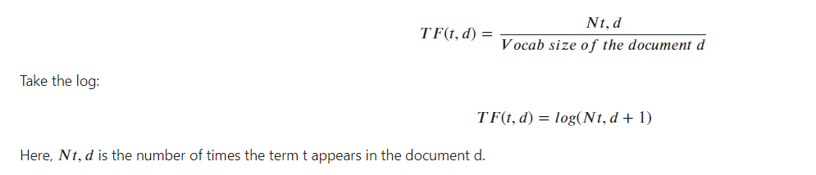
TF-IDF
There are multiple ways to calculate the tf or the idf part of tf-idf depending on whether you want to maximize the impact of rare words or lower the role of frequent ones.
For instance, when the corpus is composed of documents of varying length, you can normalize by the size of each document:

Slide 66
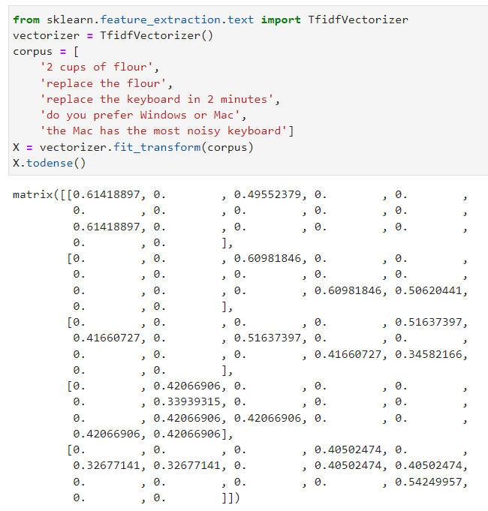
TfidfVectorizer
In scikit-learn, tf-Idf is implemented as the TfidfVectorizer

Slide 67
CountVectorizer vs TfidfVectorizer
Choosing the CountVectorizer over the TfidfVectorizer depends on the nature of the documents you are working on. Tf-idf does not always bring better results than merely counting the occurrences of the words in each document!
Here are a couple of cases where tf could perform better than tf-idf :
If words are distributed equally across the documents, then normalizing by idf will not matter much
If rare words do not carry valuable meaning to the classification model, then td-idf does not have a particular advantage.
For the CountVectorizer and the TfidfVectorizerWords, words that are not in the corpus do not get a vector representation, meaning that the vocabulary size and elements are also entirely dependent on the corpus at play. In short, they both give a numerical representation of words entirely dependent on the nature and number of documents being considered. The same words will have different vector representations in another corpus.
We will now explore numerical representations of words called embeddings (Word2vec, GloVe, fastText). These techniques are absolute and not dependent on the corpus, which is an important distinction!

Slide 68
4. Text vectorization
Word embeddings

Slide 69
5. Sentiment analysis modeling
Sample submission

Slide 70
5. Sentiment analysis modeling
Your turn!

Slide 71
6. L'Oreal case: custom NER model using prodigy and spacy
???

